Slide 1

Group B Simulation
Andrew Meng, Kathi Munoz, Joseph Zou

Slide 2
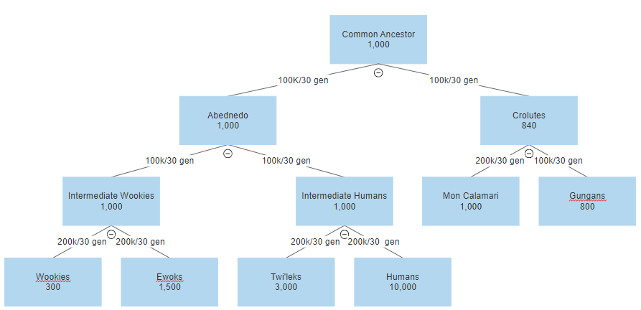
Population History Tree

Slide 3
Interesting population dynamics
Gen 15000: Gungans have a war - population shrinks from 800 to 200
Gen 15500: Human pop splits - colony goes out into space… migration rate to the colony of 0.01
Gen 15800: Gungans recover a bit - population grows to 400
Gen 20000:
Wookies hit hard times - population shrinks from 1500 to 300
Main human population goes gangbuster - grows from 1500 to 10000
Twi’leks are doing good - grows from 1500 to 4000
Gen 24800: Twi’leks hit a rough patch - shrink to 3000

Slide 4
Gene Locations and Fitness
7001-11623: Respiration f=0.01, negative for Crolutes and all its descendants
14633-17004: Fur f=-0.01, positive for intermediate Wookies and all its descendants
35532-36943: Size f=0, negative for Ewoks, positive for Wookies
49183-53668: Eye shape/placement f=0.01, negative for Gungans
72757-77368: Skin color f=0, positive for Twi’leks
84308-87332: Head shape f=0, positive for Twi’leks
Notes:
Respiration negative for Crolutes+descendants because they are amphibious; Fur positive for int Wookies, Wookies, Ewoks because… furry; size negative for Ewoks because they are better off small, opposite for Wookies; eye shape/placement negative for Gungans because they protrude weirdly, skin color positive for Twi’leks because they tend to be colorful; head shape positive for Twi’leks because they have lekku (things on head)

